Slide 1
Project Lagro Presentation Title Slide
Microsoft & LinkedIn
Project Lagro

Slide 2
Agenda
Welcome
Introduction to Project Lagro
What is a Private preview?
Project Lagro preview program
Q&A

Slide 3

Feedback
Project Lagro Introduction

Slide 4

What is Project Lagro?
Project Lagro is a Microsoft Teams app powered by Azure services and LinkedIn Economic Graph data for students to explore jobs, identify their skill gap, and discover people and learning resources to support their career goals.

Slide 5
The mission of Microsoft is to empower every person and organization on the planet to achieve more. Microsoft believes technology can and should be a force for good and that meaningful innovation can and will contribute to a brighter world in big and small ways.
The mission of LinkedIn is to connect the world’s professionals to make them more productive and successful. LinkedIn is the world’s largest professional network with more than 610 million users in more than 200 countries and territories worldwide.

Slide 6







LinkedIn Statistics
LinkedIn is the largest network of professionals in the world, and a primary recruiting ground for companies, especially for technical and professional jobs.
660M
30M
20M
36K
90K
46M
Members
Companies
Open jobs
Skills
Schools
Students & recent graduates
Notes:
We are operationalizing our data in pursuit of this vision to build the world's first Economic Graph. In short, the Economic Graph is all the data on LinkedIn - and the use of that data to gain a real understanding of what’s happening in the global economy in real-time through the activity our member community. It’s a continuously updated digital representation of 590M members, 30M companies, 20M jobs, 50K skills, 84K schools, and over 109B member UPDATES viewed.
We have organised our data to draw out labor market insights that can become a dynamic source of information for individuals, companies, educational institutions, non-profits and multi lateral organizations to make decisions on jobs, skills, curriculum and training.
And, we are doing something that is really challenging, it's hard, it takes time and effort. We are working with government to harness our data source to help inform policy change.

Slide 7
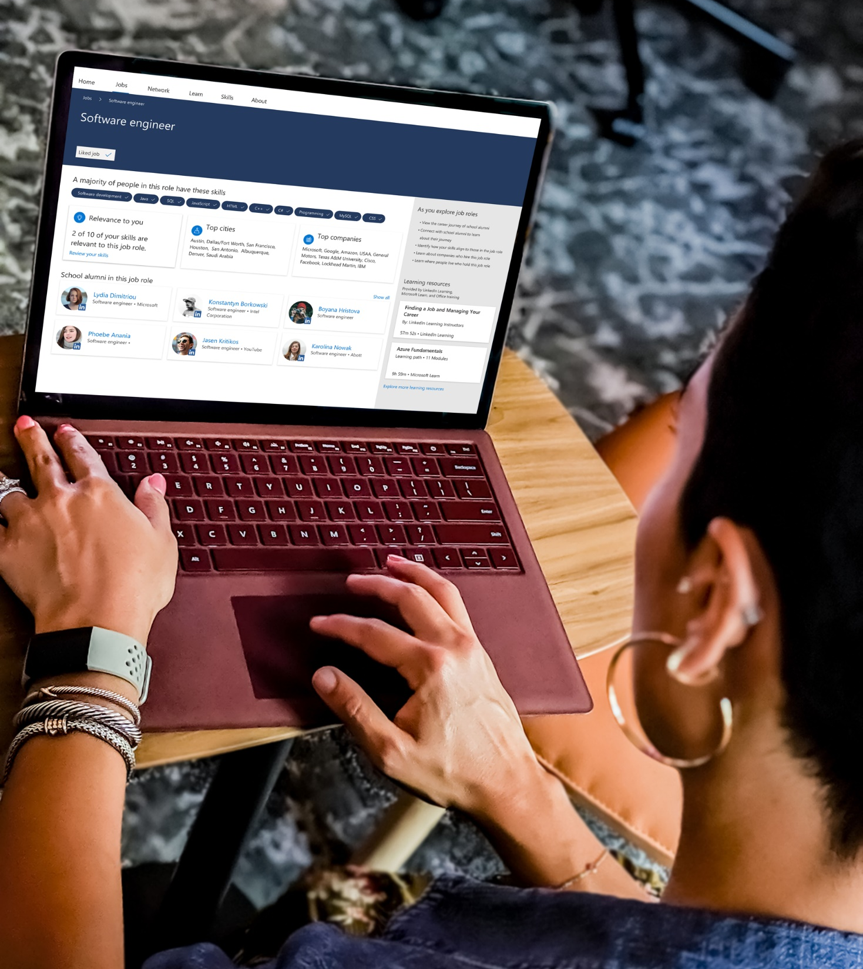
College graduate market statistic
80% of college graduates want to find purpose in work, but less than half of graduates succeed in doing so.
^{(Gallup 2019)}
Notes:
Gallup, Inc. (2019, May 16). Forging Pathways to Purposeful Work: The Role of Higher Education. Retrieved from https://www.gallup.com/education/248222/gallup-bates-purposeful-work-2019.aspx

Slide 8

College experience statistics
College experiences that impact finding purposeful work
I had an internship that allowed me to apply what I was learning in the classroom.
There was someone who encouraged me to pursue my goals and dreams.
I was given realistic expectations for my employment prospects upon graduation.
I participated in a class or program that helped me think about looking for meaningful work.
^{(Gallup 2019)}
People with the strongest networks were 4x more likely than those with the weakest networks to say that they are very satisfied with their jobs.
^{(LinkedIn 2019)}
Notes:
Gallup, Inc. (2019, May 16). Forging Pathways to Purposeful Work: The Role of Higher Education. Retrieved from https://www.gallup.com/education/248222/gallup-bates-purposeful-work-2019.aspx
Internal LinkedIn report “Your network matters: Survey shows that actions and attitudes toward building your network can lead to career benefits” LinkedIn Economic Graph, 2019.

Slide 9

Project Lagro’s purpose
Project Lagro addresses the needs of students, universities, and employers

Slide 10



Goals of Project Lagro
Project Lagro
value areas
 | Students | Universities | Employers
Jobs and Careers | Discover job roles, people, and career paths aligned to your career goals | Insight into student career goals, alumni career paths, and labor market trends | Increase role and company fit with university recruiting
Network and Community | Build community to support your career goals | Build university communities - students, alumni, faculty, and staff. | Build relationships with universities and students
Skills | Identify the skills gained from your past experiences and skills aligned to your career goals | Insight into student skills and hiring trends to inform curriculum development | Increase recruiting efficiency
Learn | Find learning aligned with your skill interests and career goals | Decrease student time + cost to get a degree | Leverage life-long learning skill for future workforce.

Slide 11
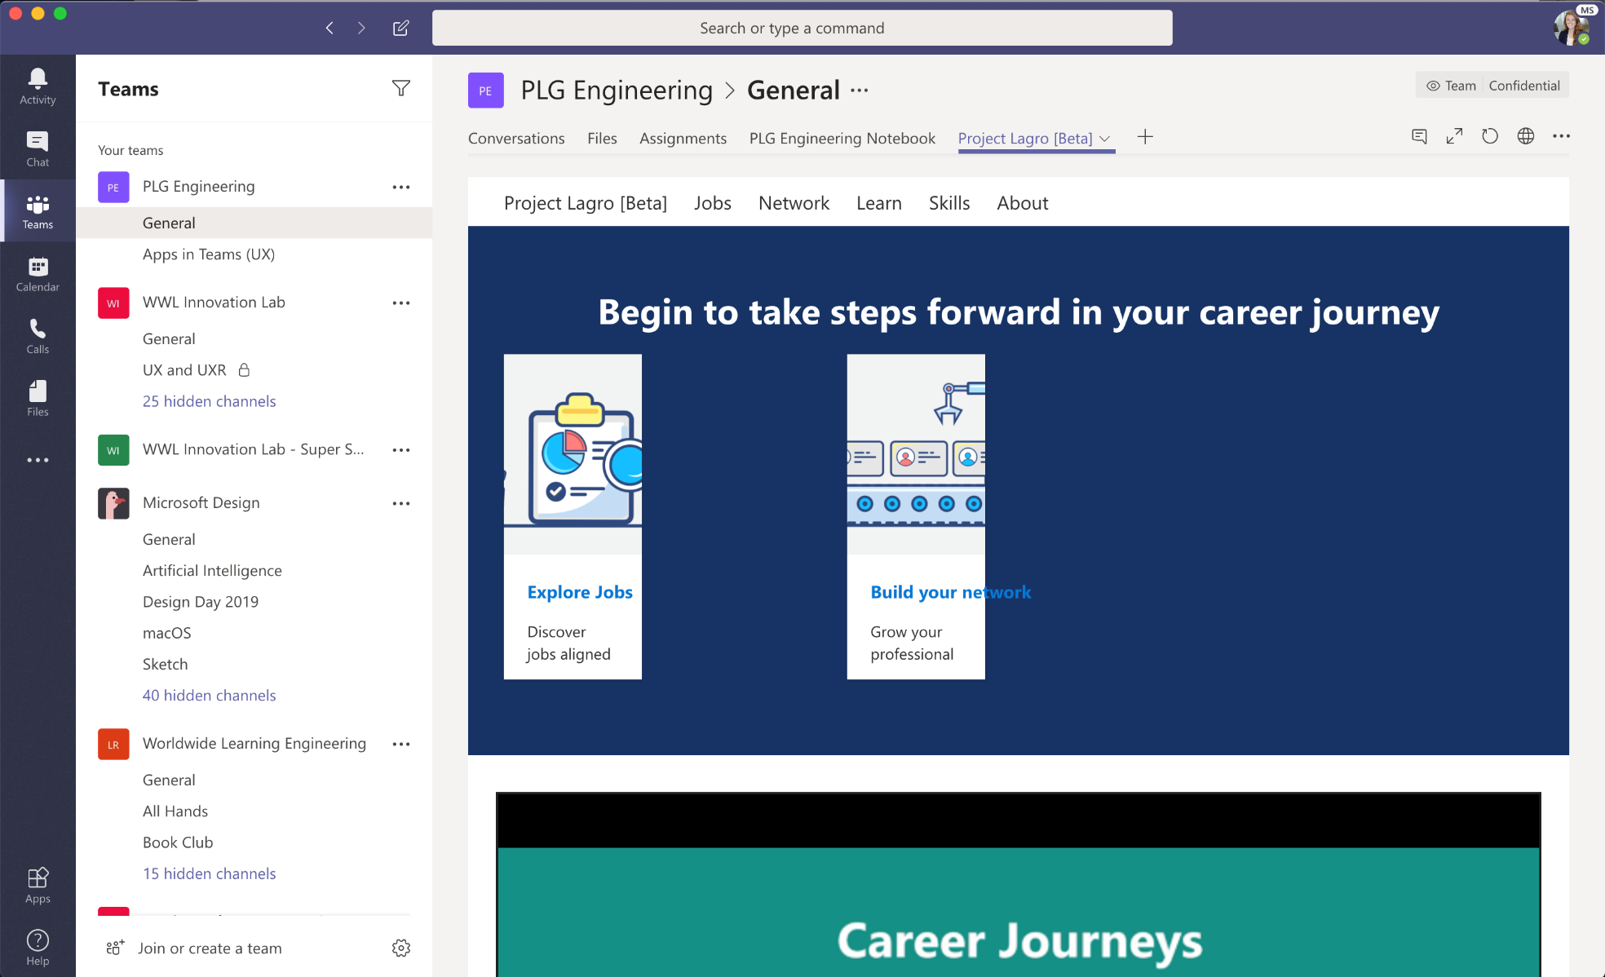
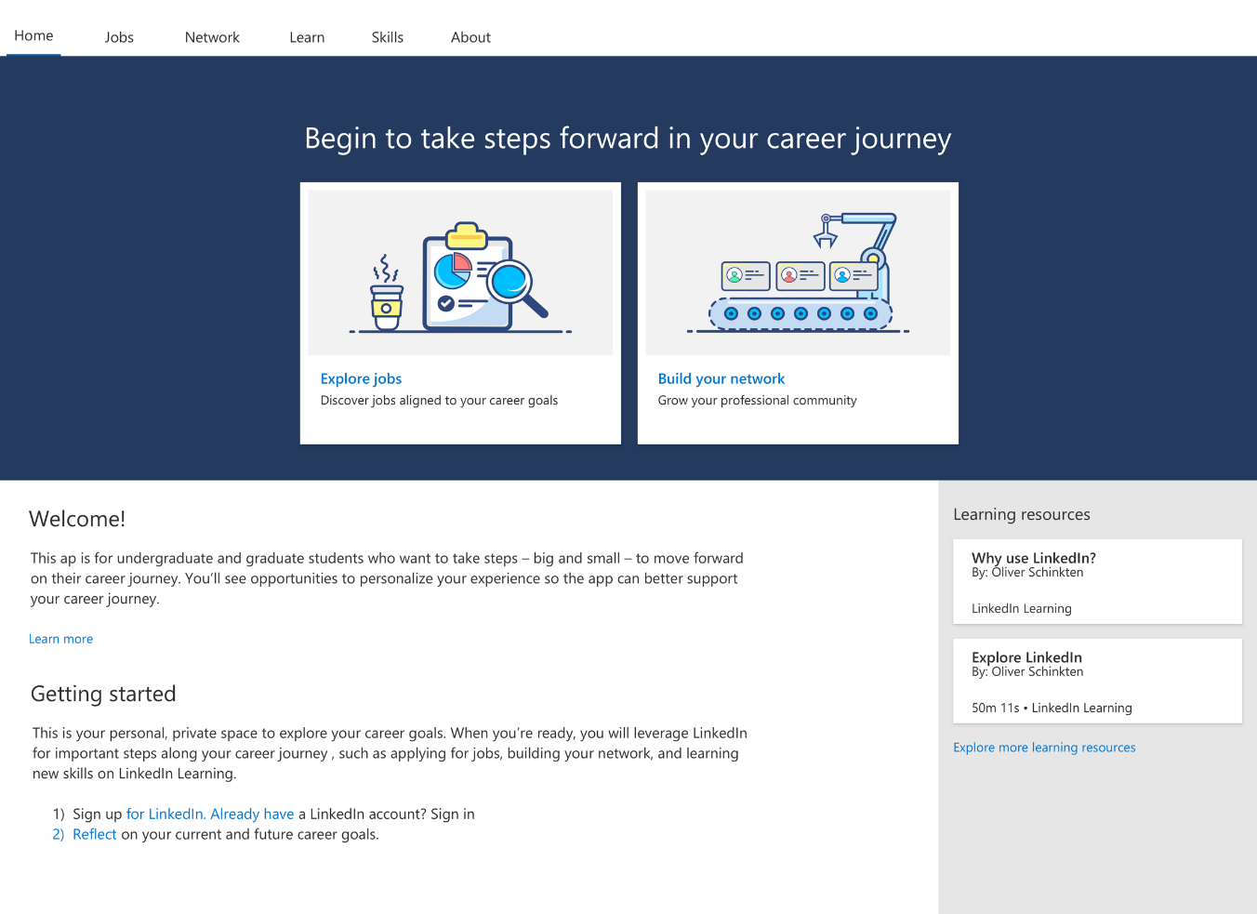
Microsoft Teams tab application
Available as an app within Teams

Slide 12
Feedback
Project Lagro Demo

Slide 13
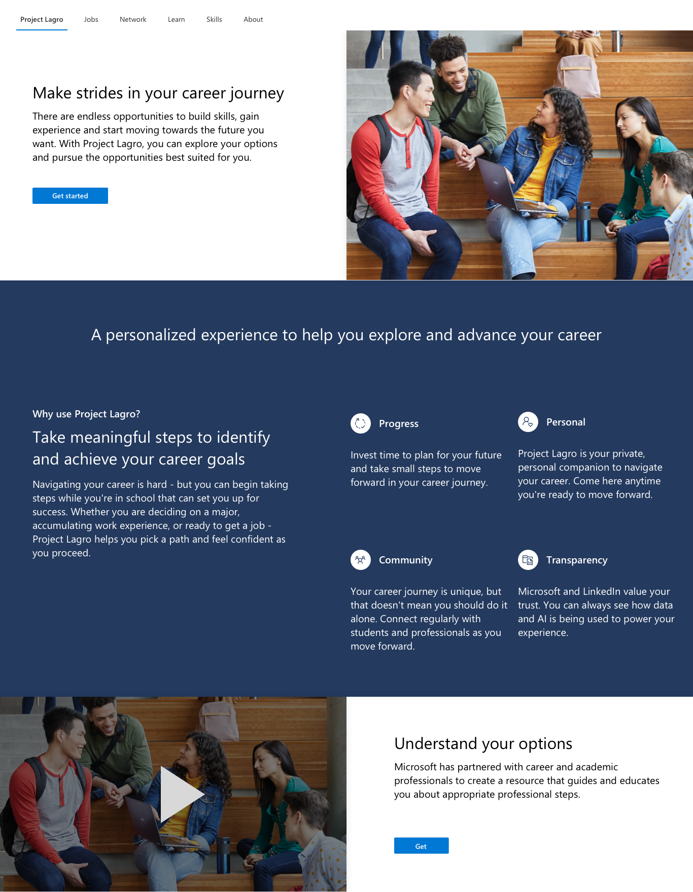

Slide 14
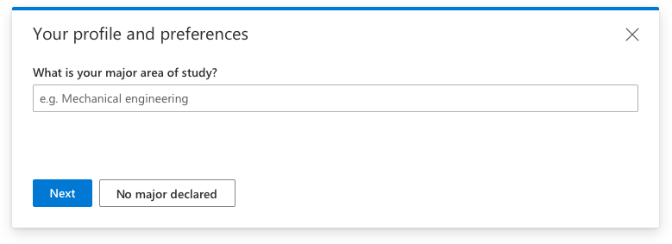

Slide 15
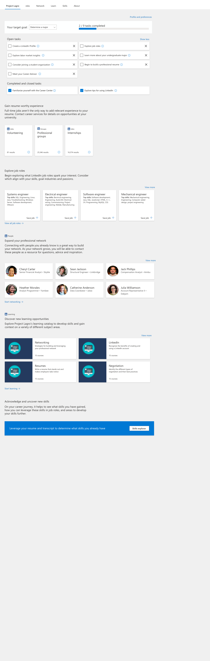

Slide 16
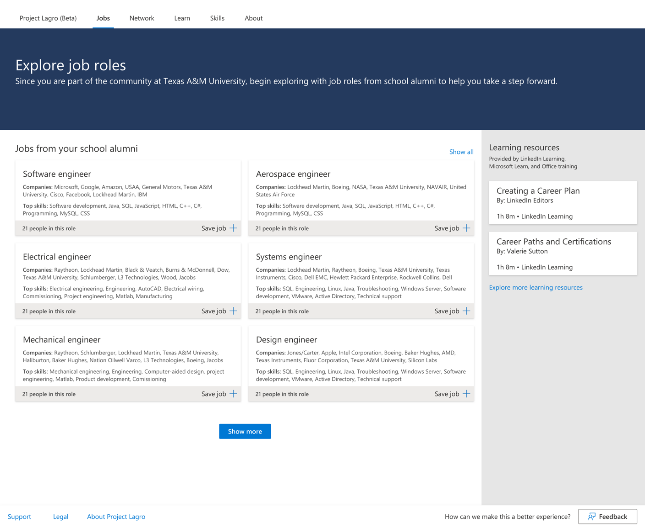

Slide 17
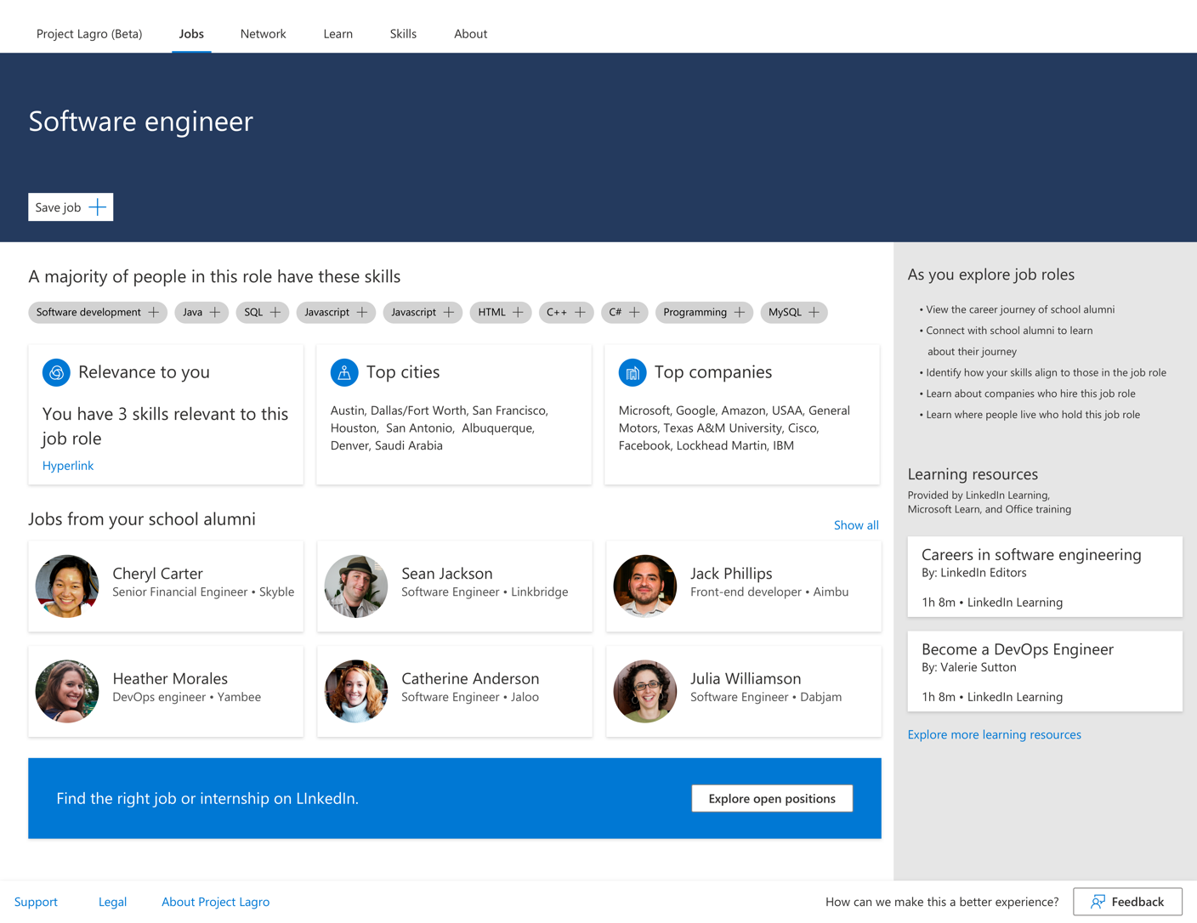

Slide 18
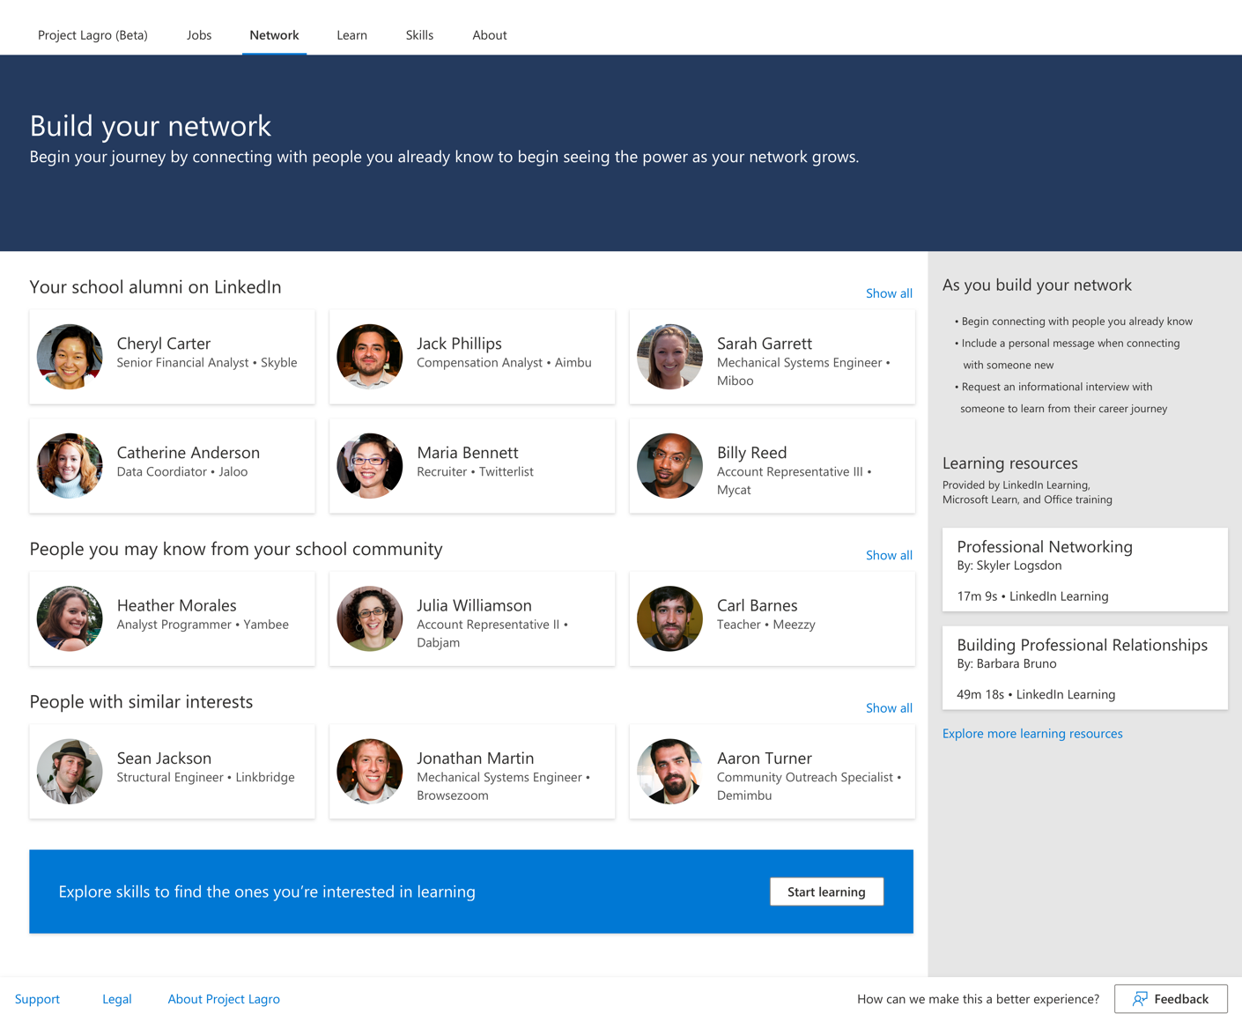

Slide 19
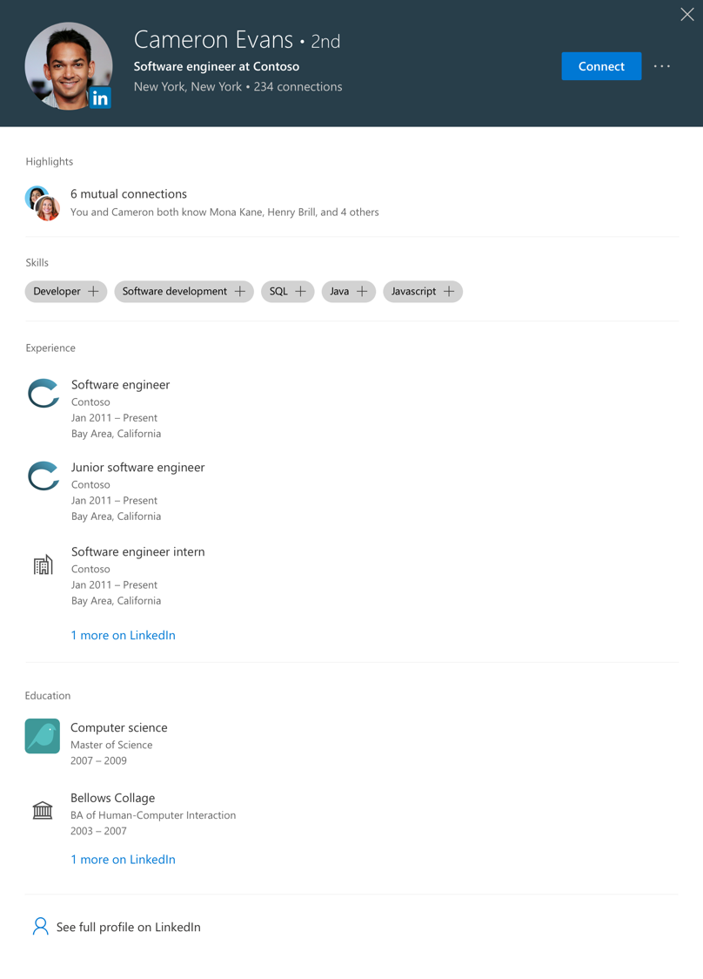

Slide 20
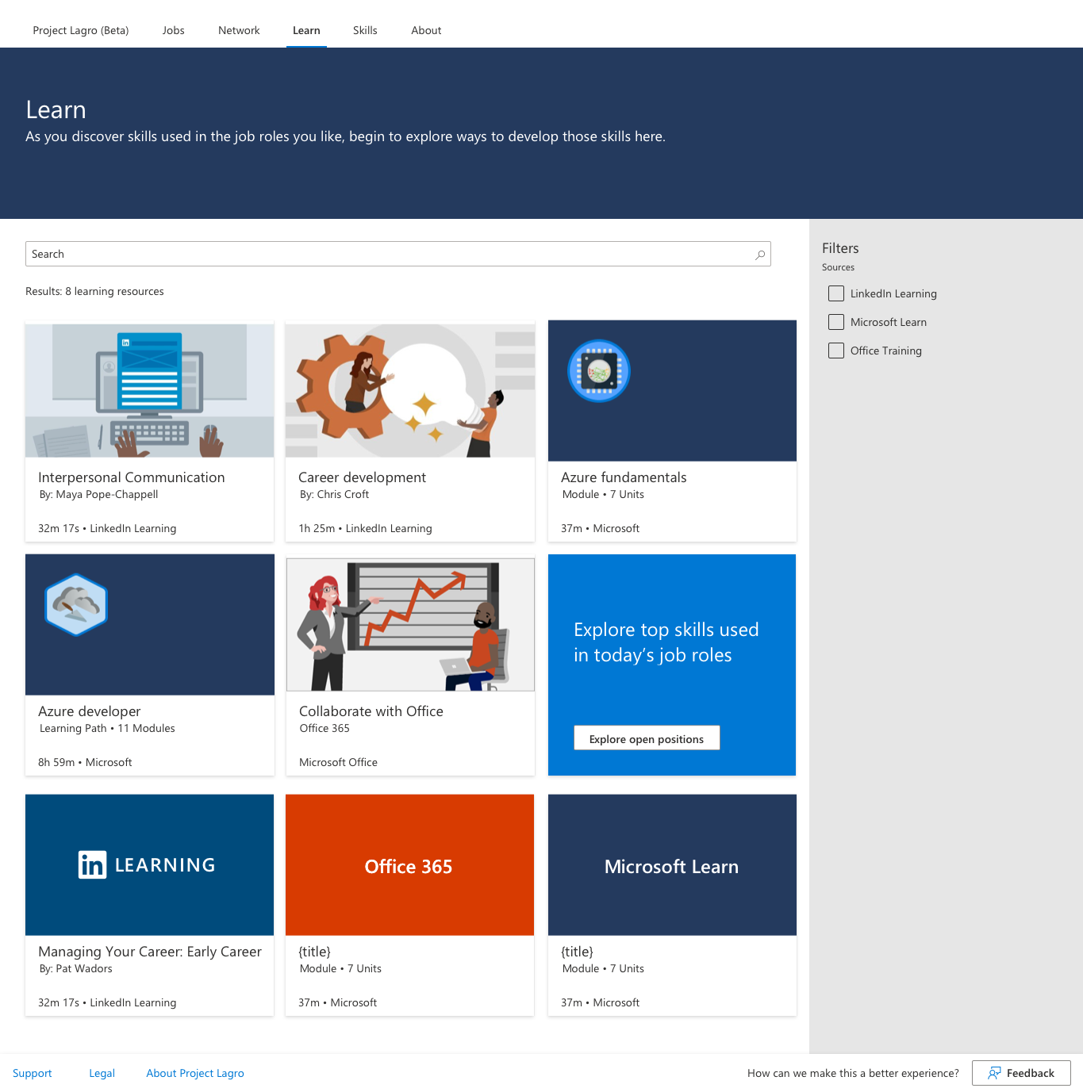

Slide 21
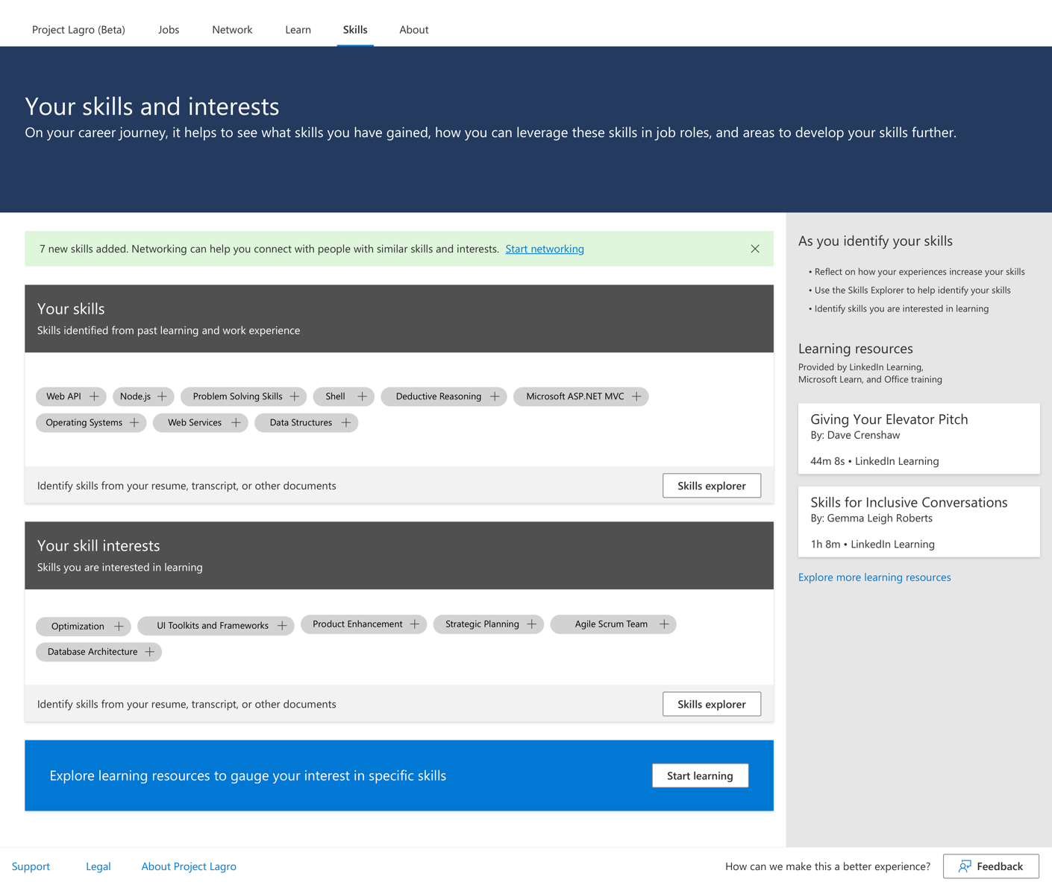

Slide 22
University insights
Project Lagro usage – see PowerBI example
Skills identified from university course catalog
Labor market insights from LinkedIn Economic Graph
Top skills required in the market
Fastest growing employers
Skill Migration
Largest Employer
The 30 most unique skills of an occupation
Alumni insights – current jobs, company, location, skills, degree, etc.

Slide 23
Feedback
You’re invited to participate

Slide 24
What is a Private preview?
Goal of a preview is to obtain feedback while early customers evaluate the preview.
A preview may include preview, beta, or other pre-release features, services, software, or regions.
Previews are subject to reduced or different service terms, as set forth in your service agreement and the preview supplemental terms.

Slide 25
Project Lagro preview
Goals:
Test Project Lagro hypotheses
Research Student, University, and Company value and preferences
Develop a successful go to market strategy
Improve product experience based on student and stakeholder feedback
Preview target market:
English speaking
4-year universities
2-year community colleges

Slide 26
Benefits of participating in the private preview
Early use of beta product version and students gain an experience for their resume.
Top engaged students receive a LinkedIn recommendation from a Microsoft team member.
Monthly reviews to advise on upcoming product features
Preview university insights for students and alumni
Increase thought leadership in using technology to address student success.
Opportunity to participate in a customer case to share globally once Project Lagro is launched to the public.

Slide 27
University contributions for the private preview
Engage 1,000 students minimum to participate in a Project Lagro cohort for 4 months.
Deploy technical requirements within 4-6 weeks from private preview start date
Engage universities stakeholders in IT, career services, chancellors, and faculty to sponsor, advise, and implement preview deployment
Advise on upcoming product milestones
Estimated Azure costs are $2,000-2,500 per month

Slide 28
Technical requirements
Office 365 tenant with Azure AAD, with 5 guest accounts for Project Lagro team members
Microsoft Teams deployment with channel created to install the Project Lagro app
Azure subscriptions to deploy and monitor Azure services that power Project Lagro
Course catalog and course syllabus data to identify skills gained from students’ academic experience or permission to scan online public course catalog
Pilot option is to scrape public site. Long term option is connect to university course data systems.
Student transcript data to identify university courses taken.
Pilot option is to use unofficial transcript. Long term option is to connect to Student Information System.
Enable LinkedIn account connections in Azure Activity Directory
LinkedIn Learning campus subscription (preferred)

Slide 29
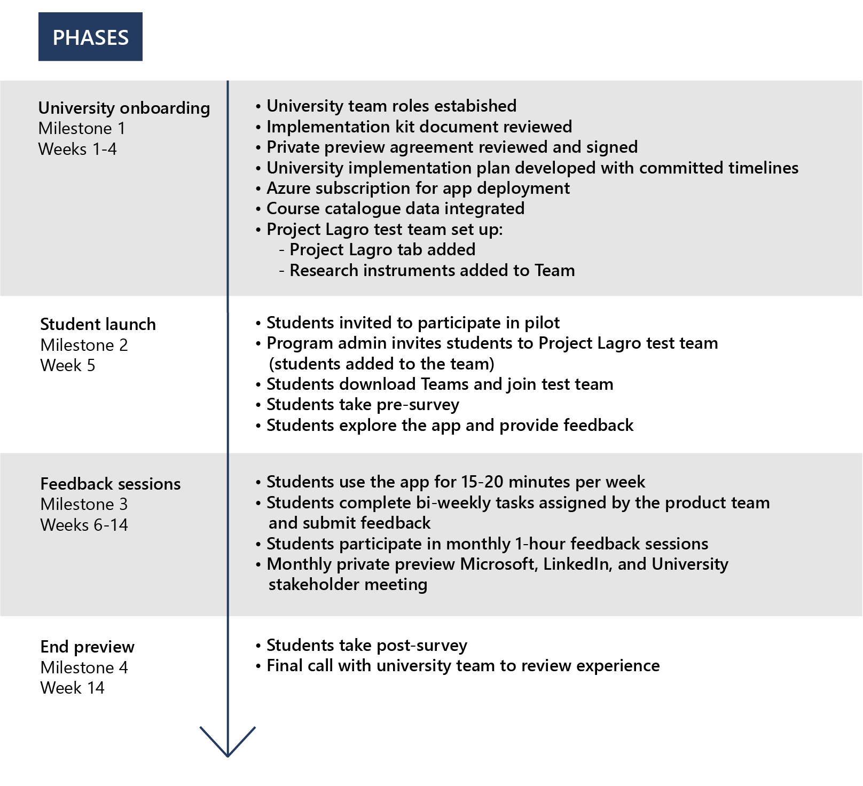
Private preview implementation timeline

Slide 30
Preview engagement
 | Univ stakeholders | Students
Week 1 | Successful launch | Onboard students
Week 2 | Launch retrospective, review goals and plans for preview program | Pre-launch questionnaire
Week 4 | Recurring agenda Student assignment update Feedback areas – product value, student experience, offering, etc. Learning sessions – identify/plan/review | Setting up UserTesting.com account + Project Lagro initial review and reactions (unmoderated)
Week 6 |  | 1:1 feedback session (career navigation + design evaluation)
Week 8 |  | Networking value, tools, and methods
Week 10 |  | Skills confidence and skill gap awareness
Week 12 |  | Learning habits and tools (skills acquisition confidence)
Week 14 | Research summary report out | Reward students based on engagement level Report out to education institute all up research engagement outcomes
Notes:
*Engagement plan (WiP)

Slide 31
Q&A
Contact Alicia Redmond alboaz@microsoft.com with any questions

